Slide 1
Building LLM Applications with Prompt Engineering
Introduction

Slide 2
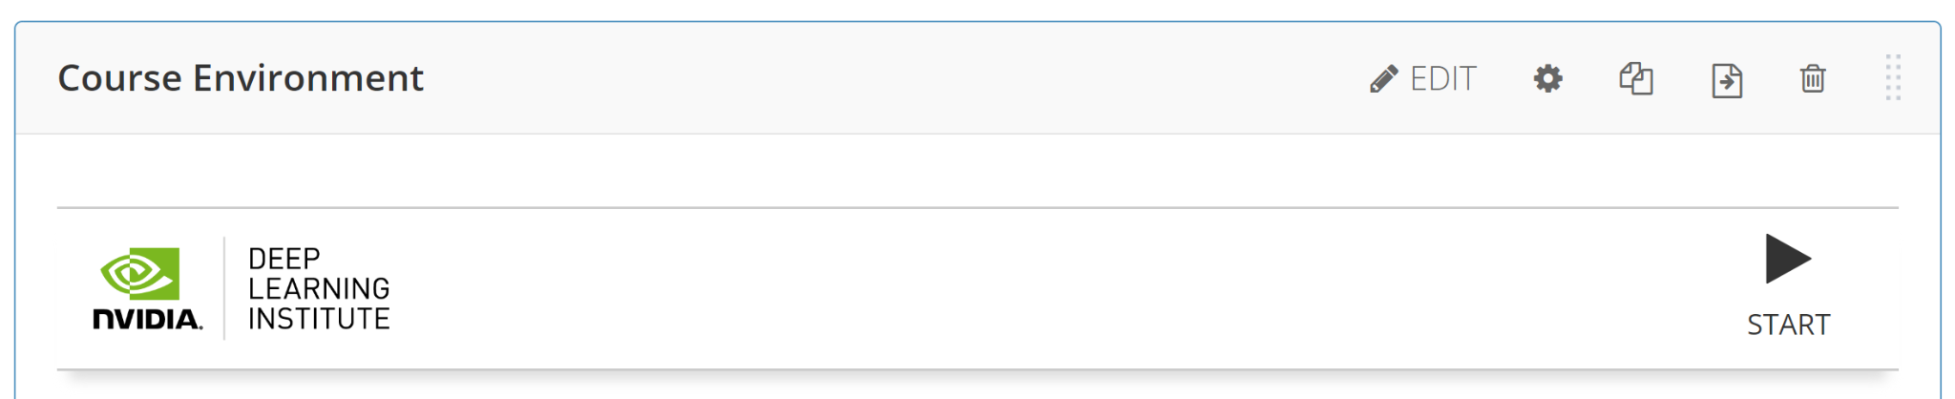
Building LLM Applications with Prompt Engineering
Introduction

Slide 3





Large Language Models
Artificial Intelligence system designed to understand, generate, and process human language
2022
2023
TODAY
Explosion
ChatGPT gets announced late in 2022, gaining over 100 million users in just two months. Users of all levels can experience AI and feel the benefits firsthand.
Experimentation
Enterprise application developers kick off POCs for generative AI applications with API services and open models including Llama 2, Mistral, NVIDIA, and others.
Production
Organizations have set aside budget and are ramping up efforts to build accelerated infrastructure to support generative AI in production.
Notes:
In 2022, we witnessed not just the launch of a new technology, but a paradigm shift, a true explosion in AI capabilities with the announcement of ChatGPT. Imagine a tool so compelling that it attracted over 100 million users in a mere two months.
As the ripples of the initial explosion expanded, 2023 became the year of bold exploration. Enterprises and developers didn't just dip their toes; they dived into the ocean of Large Language model’s potential.
Now in 2024, the learning and experimentation have paid off, and organizations are poised to catapult LLMs from the sidelines into the core of their production environments.

Slide 4
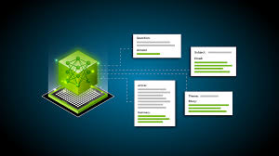
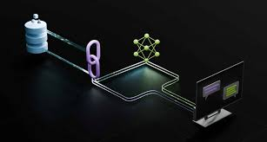
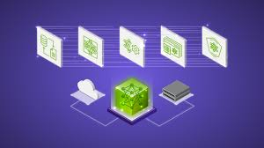
3 Methods for Interacting with LLMs
Prompt Engineering
Retrieval Augmented Generation
(Parameter Efficient) Fine-tuning
Notes:
- Simplest method to interact with LLMs
Relies on existing knowledge within the model
Combines LLMs with external knowledge retrieval systems
Involves additional training of pre-trained model on a specific dataset, but requires significant computational resources to modify model’s internal parameters

Slide 5
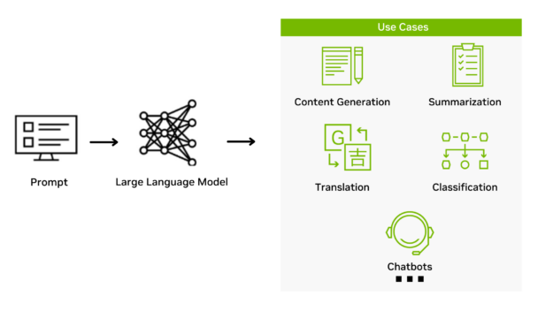
Goal of this Course
Learn to interact programmatically with Chat-variant LLMs
Be capable of using LLMs for a wide variety of application use cases
Become fluent with fundamental LangChain techniques
Develop good habits around iterative prompt engineering

Slide 6
Goal of this Course
Introduction to Large Language Models (slides)
NVIDIA NIM (slides)
Intro to Prompting (interactive)
LCEL Chains (interactive)
PE techniques w/ messages (interactive)
Chatbots (interactive)
Structured data and document tagging (interactive)
Tools and Agents (interactive)

Slide 7
Course Content
Introduction to Large Language Models (slides)
NVIDIA NIM (slides)
Intro to Prompting (interactive)
LCEL Chains (interactive)
PE techniques w/ messages (interactive)
Chatbots (interactive)
Structured data and document tagging (interactive)
Tools and Agents (interactive)

Slide 8


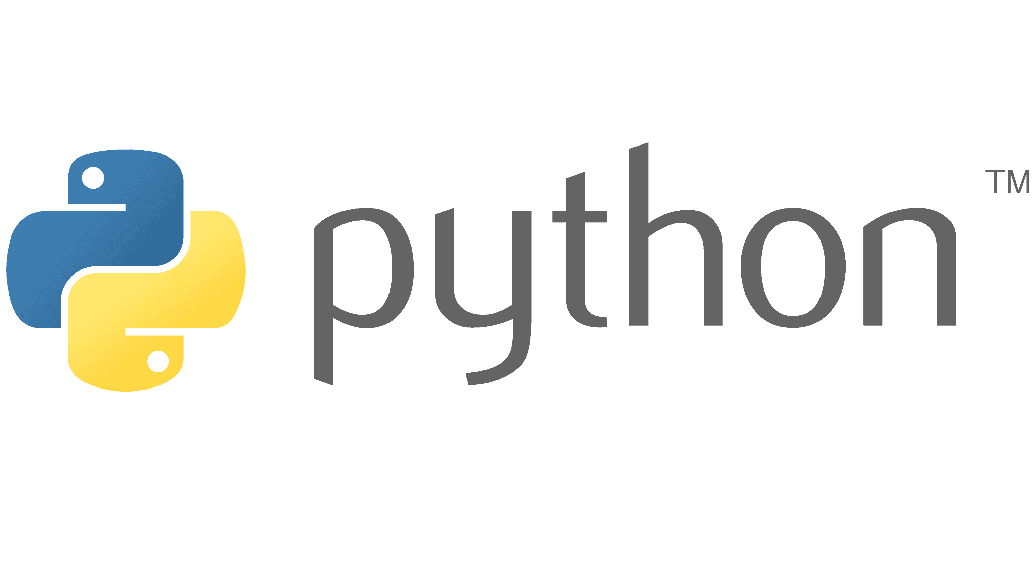
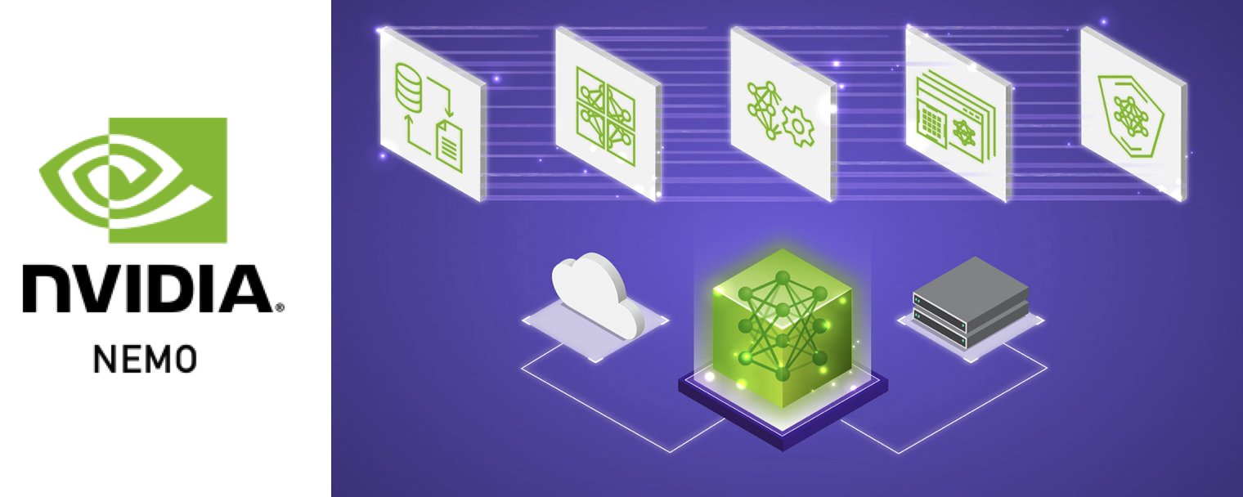
Prerequisites
Building LLM Applications with Prompt Engineering
Basic Python Proficiency
Prior LLM Exposure
Plus: Experience with LangChain or Knowledge in Natural Language Processing

Slide 9
Building LLM Applications with Prompt Engineering
Introduction to Large Language Models

Slide 10
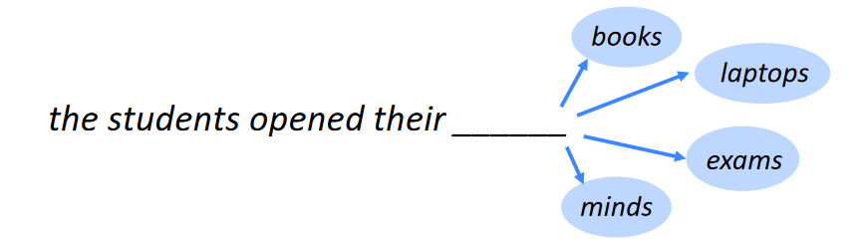
What is Language Modeling?
Notes:
- Artificial Intelligence system designed to understand, generate, and process human language
Language modeling: calculating how likely is given string (observation)
These supervision comes from raw text data with no explicit human labelling

Slide 11




Large Language Models Pipeline
Notes:
A typical pipeline of training LLMs is collecting massive data, crawled from various websites such as Wikipedia, books, and news, so we have billions and trillions of words.
Our language model can learn from these pairs of self-supervised data to identify patterns given text and output most probable subsequent word.

Slide 12
Large Language Models
Notes:
LLMs typically learn 10+ billions of parameters through this data. For every input, the model outputs a probability distribution and it maximizes the likelihood of the correct word.

Slide 13
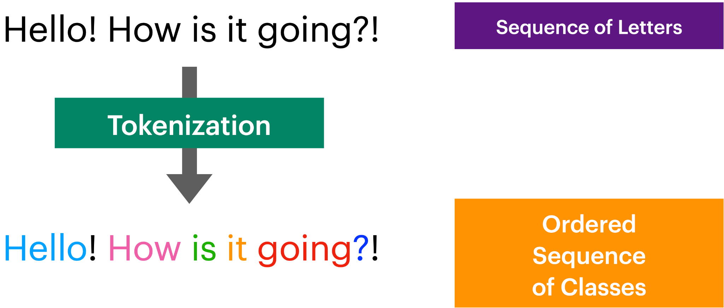
Training LLMs: Tokenization
Notes:
So how do LLMs take text inputs? It first conducts tokenization on these training data.
Tokens are basic units of input to LLMs. They can be simply thought of as subwords and the process of tokenization is breaking down an input into a sequence of tokens.
While there are many different tokenizers, I am going to briefly discuss of Byte-Pair Encoding tokenizers function. Tokenization starts with breaking the input down into characters and punctuations, finding common pairs by scanning the large training corpus of text (the name of byte-pair encoding, and merging the pair to create new tokens. There is a limit to the vocabulary size this limit has been increasing as the LLMs gets bigger and bigger.
Once the tokenizer has reached its limit, each unique token in the final vocabulary is assigned a unique numerical value. With this set of unique tokens saved in a list, LLMs now process text in terms of these tokens.

Slide 14
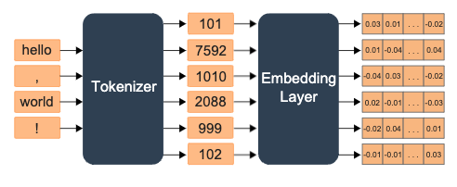
Training LLMs: Embedding
Notes:
These tokenized data then go through something called embedding layer. The Embedding Layer within the LLMs is responsible for mapping tokens to their corresponding embeddings which is high-dimensional vector space.
Within these embedding layers, neural network combined with Transformers architecture is employed which allowed for parallelization in training sequential data.

Slide 15
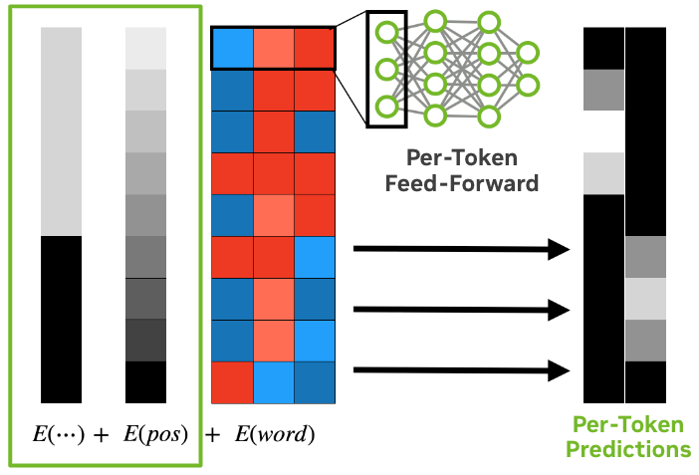
Training LLMs: Embedding
Notes:
Transformer architectrue also facilitate communication of both per-token and sequence-level information.
This dual approach allows contextual embeddings to capture not only immediate word associations but also dependencies that span across longer phrases or sentences.
These capabilities are the essence of what makes transformer-based LLMs so powerful.
We are not going to deal with how Transformers architecture works and leave it at a very high level, but the key takeaway is that they allowed for parallelization in training which ultimately led to high scaling in pretraining data.

Slide 16
Large Language Models
Task | Example sentence in pre-training that would teach that task
Grammar | In my free time, I like to {code, apples}
Lexical Semantic | I went to the store to buy papaya, dragon fruit, and {pineapples, croissant}
World Knowledge | The capital of South Korea is {Seoul, Paris}
Sentiment Analysis | Movie review: I was engaged and on the edge of my seat the whole time. The movie was {bad, good}
Math Question | Arithmetic exam answer key: 3 + 8 + 4 = {15, 384}
Translation | The word for pretty in Spanish is {bonita, hola}
Next-token prediction task
Massively Multi-task learner capable of doing all sorts of tasks
Hard to control the text generation
Notes:
Thanks to the large amount of data, while LLMs have been trained on the main objective of predicting the next most likely token, they emerged to become massively multi-task learner capable of doing all sorts of tasks.
MMLU (MCQ with 4 options) contains mostly knowledge-driven questions without requiring much reasoning, while MMLU-pro contain problems that require more reasoning tasks from subjects ranging from math, physics, chem, law, engineering, and more.

Slide 17
Prompt Engineering
Prompt Engineering is asking the right question to the LLM depending on your use case.

Slide 18
Building LLM Applications with Prompt Engineering
NVIDIA NIM

Slide 19



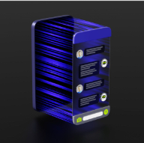

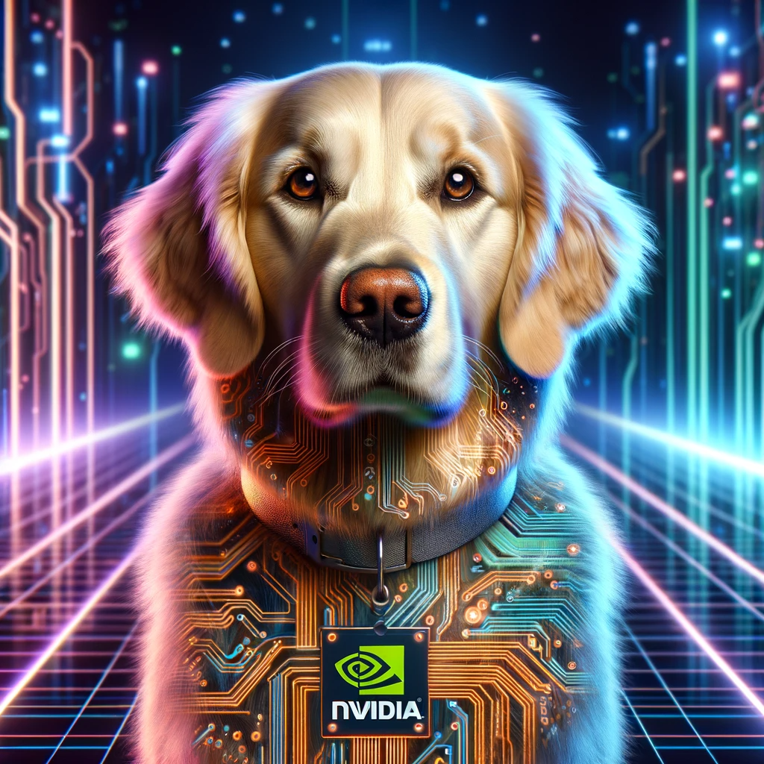


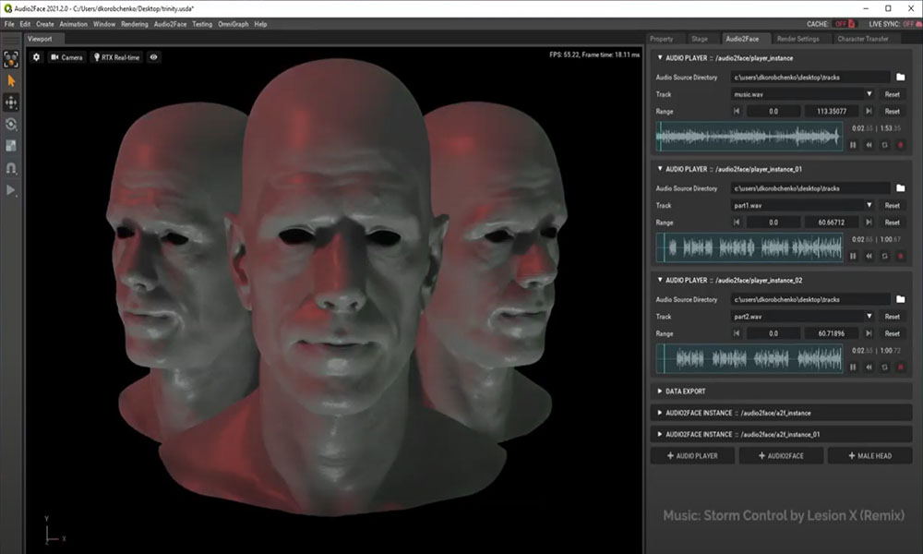
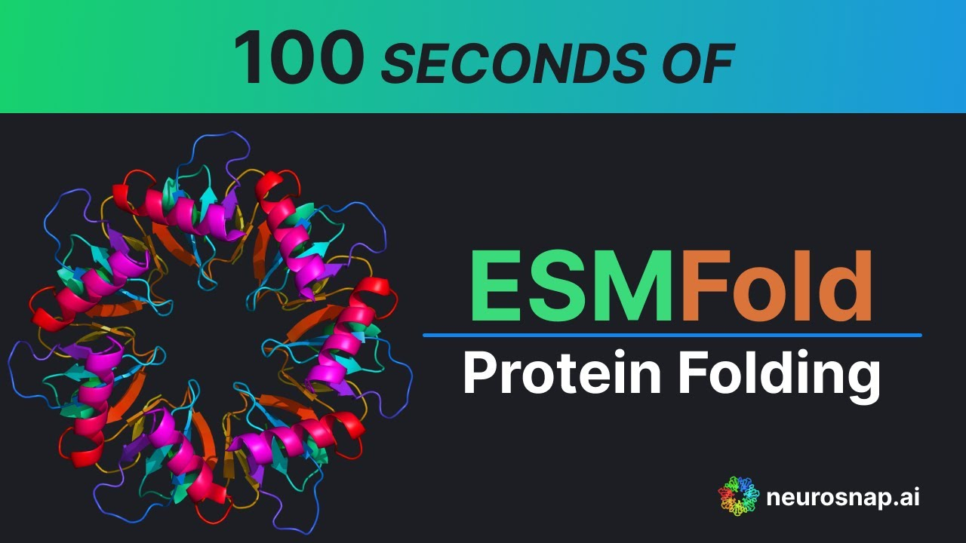

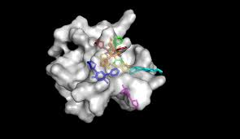
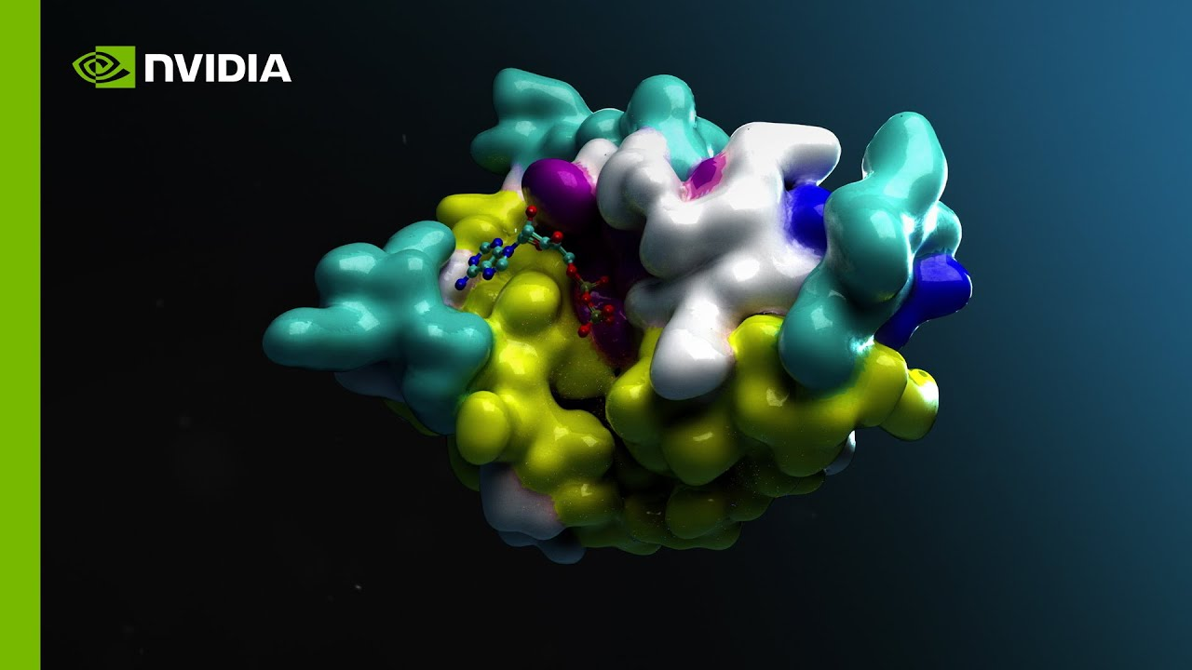

NVIDIA NIM Optimized Inference Microservices
NVIDIA NIM is the fastest way to deploy AI models on accelerated infrastructure across cloud, data center, and PC
NVIDIA NIM
Deploy anywhere with security and control of AI applications and data
Speed time to market with prebuilt, continuously maintained microservices
Prebuilt container and Helm chart
Industry standard APIs
Empower developers with the latest AI models, standard APIs and enterprise tools
Support for custom models
Optimize throughput and latency to maximize token generation and responsiveness
Domain specific code
Boost accuracy by tuning custom models from proprietary data sources​
Optimized inference engines
Deploy in production with API stability, security patching, quality assurance and enterprise support​
LLAMA 3.1
MIXTRAL 8x7B
Gemma 7B
FuYu
NeMo Retriever
AI Generator
3D Generator
Audio2Face
ESM Fold
VISTA-3D
DiffDock
MolMIM
Notes:
NVIDIA NIM is a set of easy-to-use microservices designed for secure, reliable deployment of high performance AI model inference across the cloud, data center and workstations.
Supporting a wide range of AI models, including open-source community and NVIDIA AI Foundation models, it ensures seamless, scalable AI inferencing, on premises or in the cloud, implementing industry standard APIs.

Slide 20
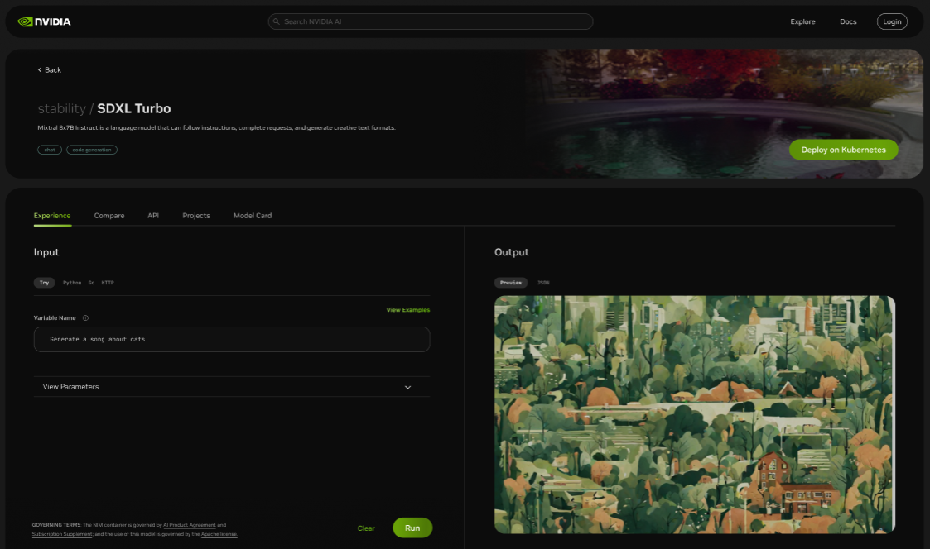
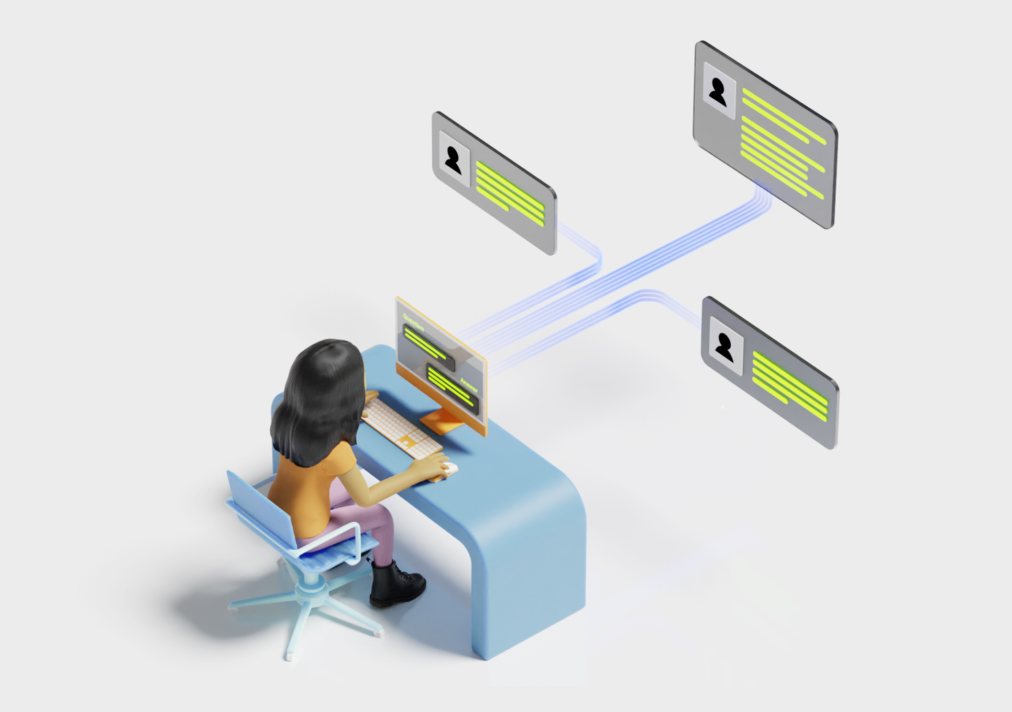
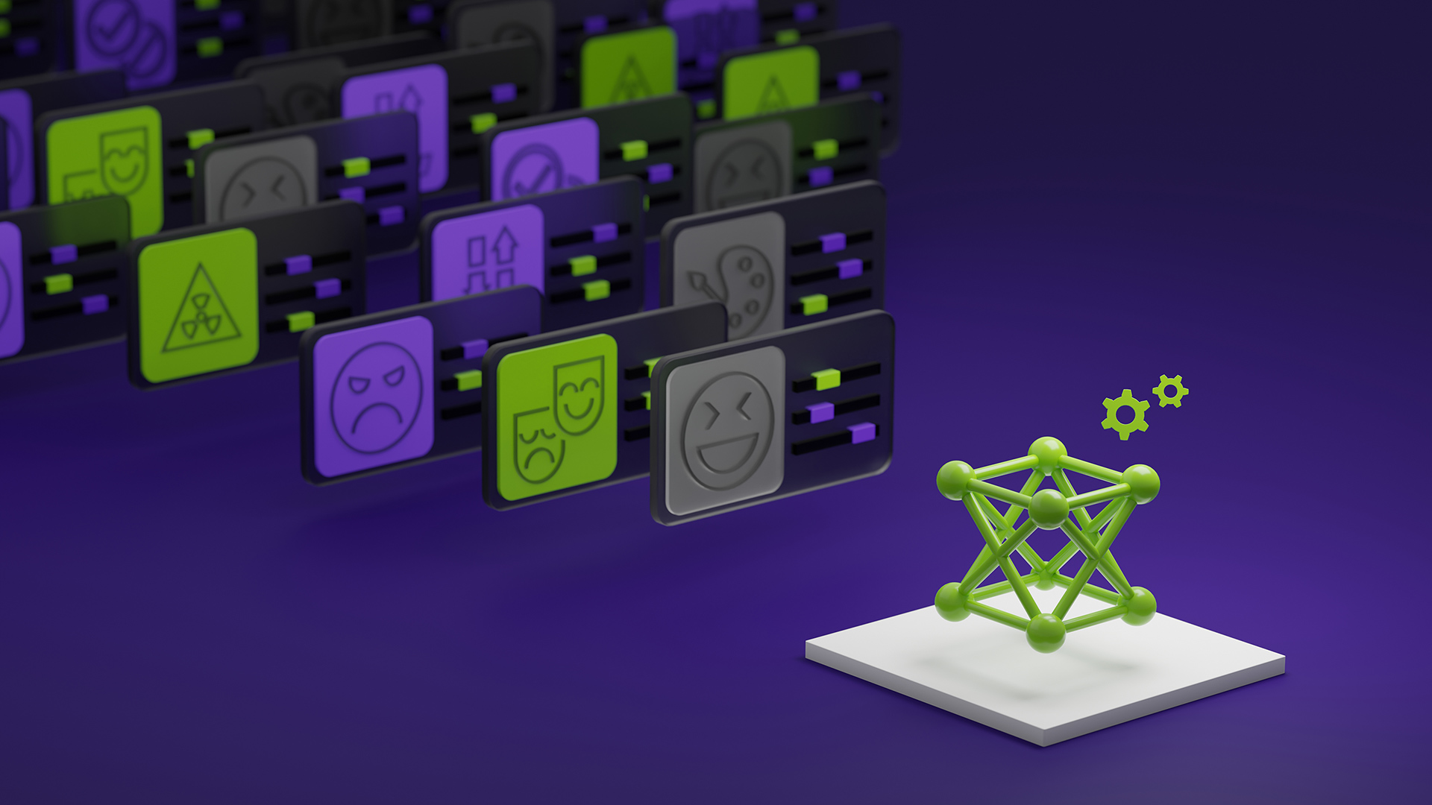

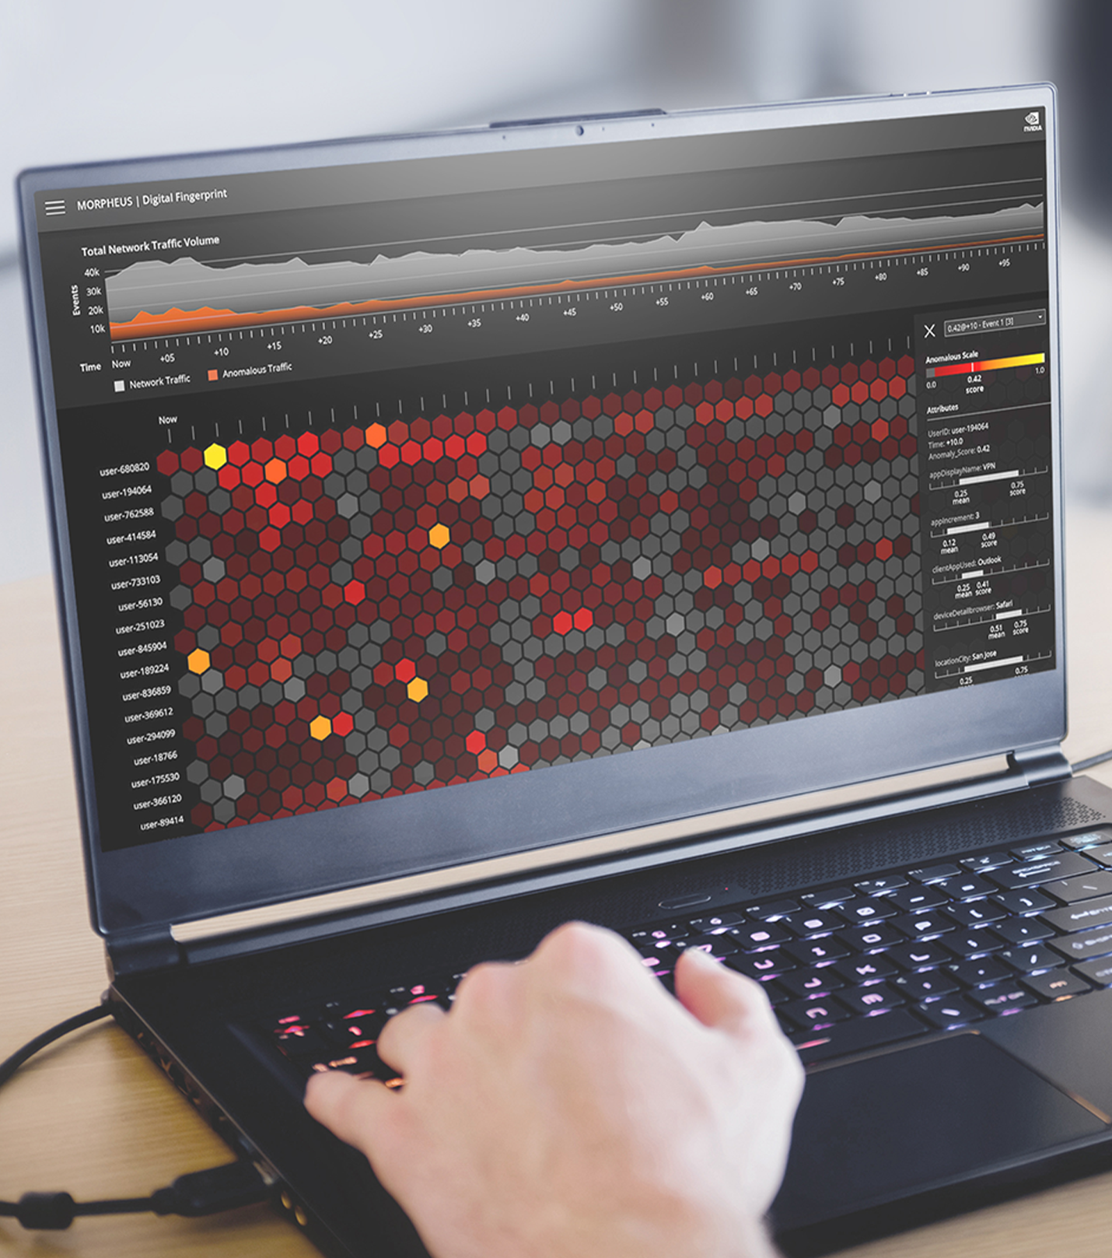
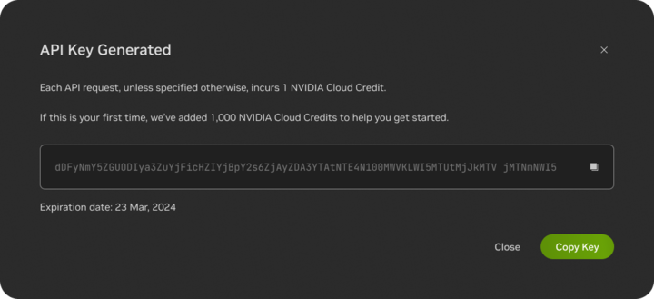

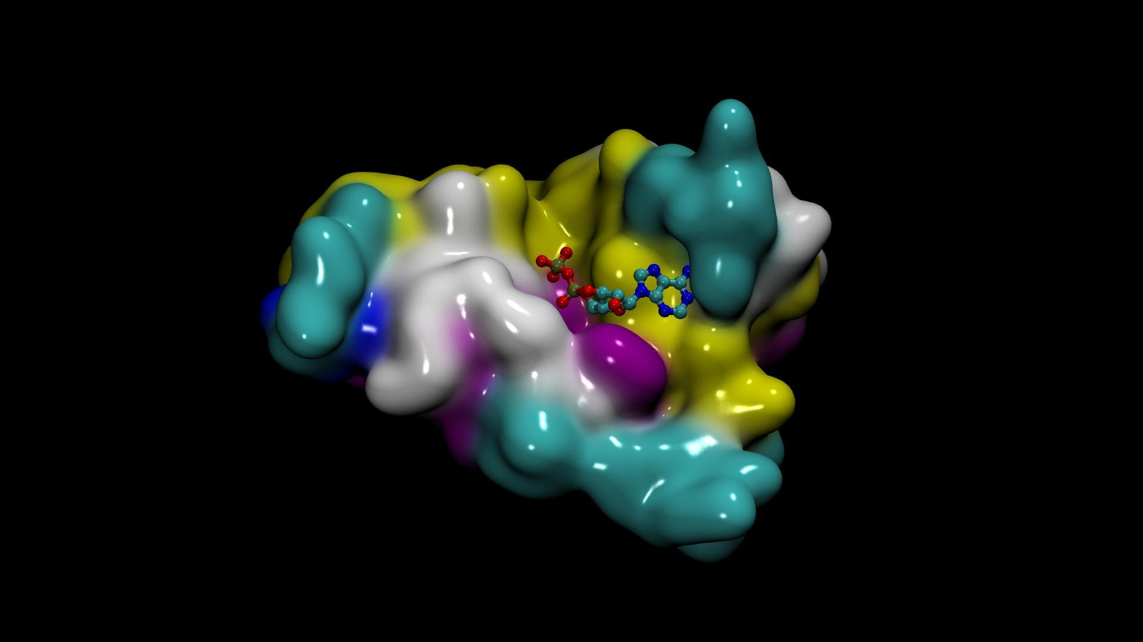

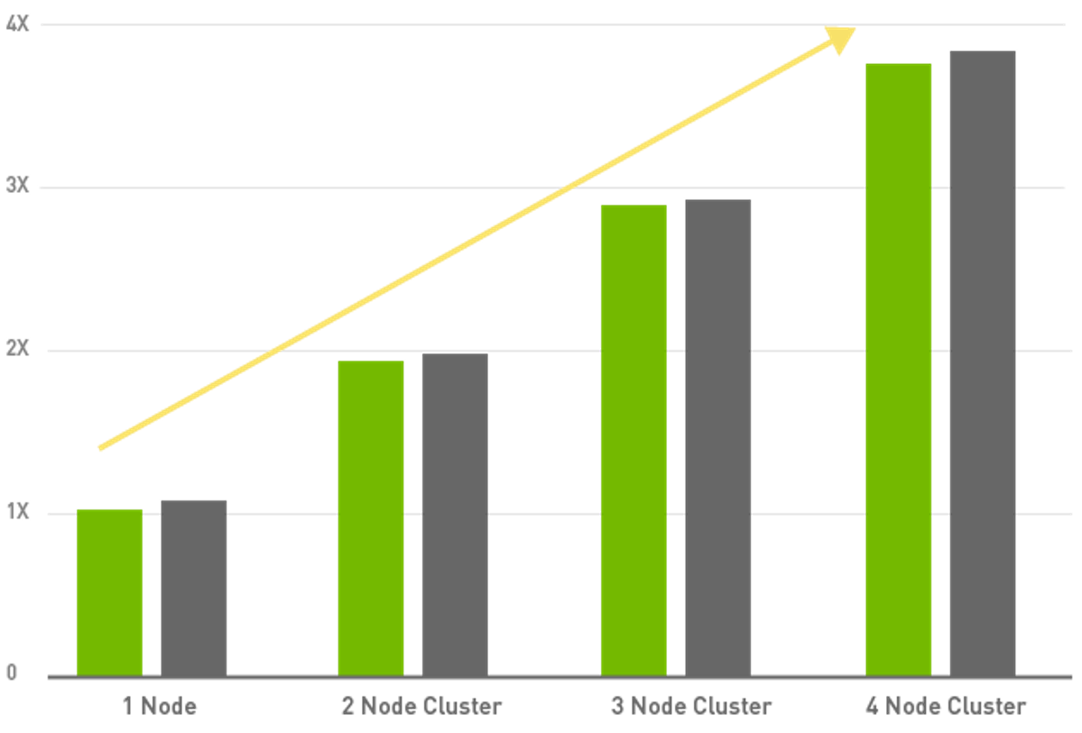

Experience and Run Enterprise Generative AI Models Anywhere
Seamlessly integrate AI in business applications with NVIDIA AI APIs
Text Summarization
Speech Generation
Security
Data Privacy
NVIDIA NIM
Drug Discovery
Visual Content
Performance Optimized
Enterprise-Support
Experience Models
Prototype with APIs
Deploy with NIMs
Notes:
There are 3 main ways to utilize Nvidia NIMs
First test out different models from build.nvidia.com
Within the website, if you want to incorporate these models into your code with the hosted APIs: first generate the API keys and use the sample code snippets on build.nvidia.com
If you want to deploy with NIMs, meaning downloading the model and running it in your local environment, you can pull the nim container after signing up an account

Slide 21
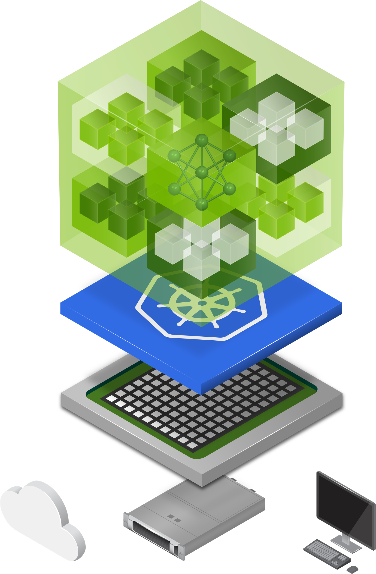
NIM Deployment Cycle
Locally-hosted LLMs reduce latency as opposed to models hosted on a public server
Scalable Deployment
Ownership of your intellectual property
Notes:
Container identifies which GPU you are utilizing and optimizes its performance depending on these different set of sufficient GPUs
Large Language Models are supported with pre-generated optimized engines for a diverse range of cutting edge LLM architecture, allowing for low latency when making inference.
API-hosted LLMs can be expensive for large-scale or high-volume needs, but local deployments offer a more cost-effective solution. By investing in the initial setup, you can scale locally hosted models easily by adding computing resources or distributing them across multiple machines.
Once set up, running a model locally gives you ownership of the customization and full control of your intellectual property and AI applications.

Slide 22
Building LLM Applications with Prompt Engineering

